Slide 1

Milwaukee Bucks Net Rating Optimization
Keith Hines
Gen. Bus. 730

Slide 2
Problem Statement
Coach Budenholzer of the Milwaukee Bucks is often criticized for his lineup choices, or which players are on the court at the same time
Is there a way to optimize which players play together, and how often?
Coaches and analysts could use a model to determine lineups and their respective minutes on the court

Slide 3
Objective
Which statistic is best to measure team and lineup performance?
Net rating is a popular efficiency stat that can be used for players, lineups and teams
Incorporates offensive and defensive performance
Net Rating = Offensive Rating – Defensive Rating
Offensive Rating: points scored per 100 possessions
Defensive Rating: points allowed per 100 possessions
Lineup net rating data is available from NBA Advanced Stats

Slide 4
Decision Variables
We can’t directly determine number of minutes for each lineup and player because Net Rating is per 100 possessions, not number of minutes
We can decide the percentage of possessions each lineup should play instead
These percentages will be multiplied by the net rating for respective lineups
Coaches and analysts can apply these percentages to their team’s historical possessions per game to determine how much of the game each lineup should play

Slide 5
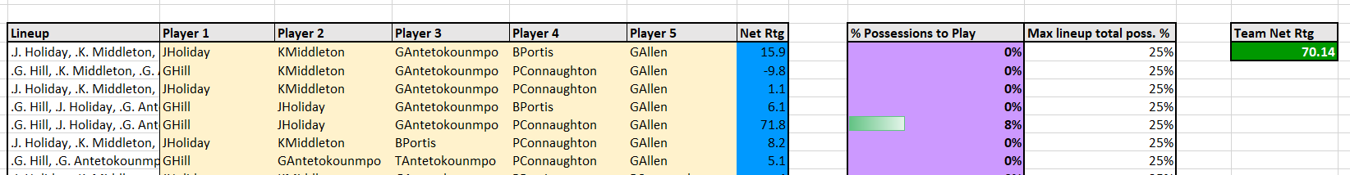
Decision Variables

Slide 6
Constraints on Minutes
Singular lineups and players cannot play entire games
We can limit the percentage of possessions each player and lineup plays
This can be updated individually
Percentage constraints can be set to zero if a player is injured or if it’s known that some lineups don’t play well against certain teams

Slide 7
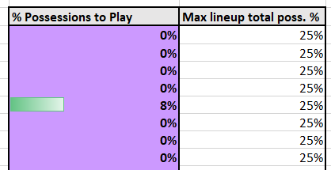
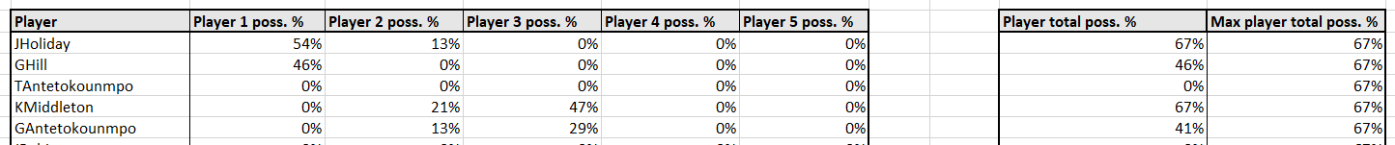
Constraints on Minutes

Slide 8
Four Factors
Besides net rating for lineups, are there other stats the team would want to consider?
Four Factors of Basketball Success
Dean Oliver determined there are four factors to determine basketball success
Shooting
Rebounding
Free throws
Turnovers

Slide 9
Four Factors
We can incorporate individual stats per 100 possessions into our model to also consider the four factors
Shooting: 3-point shots made per 100 possessions
Rebounding: Total rebounds per 100 possessions
Free throws: Free throw attempts per 100 possessions
Turnovers: Turnovers per 100 possessions
These stats will be multiplied by the total percentage of possessions for individual players

Slide 10


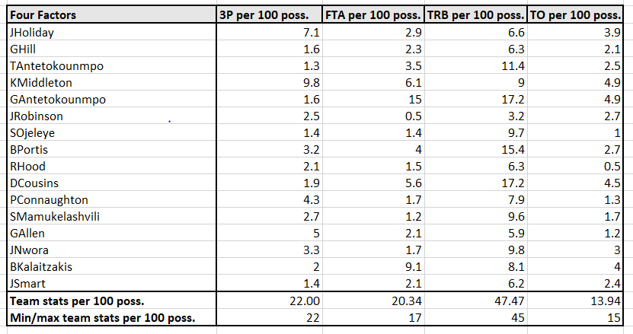

Four Factors
The stats will be summed for the team, and users can then set minimum and maximum values for each stat

Slide 11
End Use
Coaches and analysts will be able to maximize their team’s efficiency based on the optimized percentage of possessions each lineup should play
They can also adjust for injuries, matchups and individual stats
Exterior analysts and writers could use this model to evaluate coaching decisions

Slide 12
Challenges/Improvements
Difficult to scale
Lineups can easily be updated for the Milwaukee Bucks, but too much manual entry would be needed to use for other teams
Statistics would also need to be updated throughout the season
This model would be most useful with an API in Python
Stats could be updated directly from sources
Model could be iterated for every NBA team

